Slide 1




Slide 2


DEVELOP YOUR
BUSINESS
DyB

Slide 3


WHY DYB ?
India's unemployment rate increased in April 2023 to 8.11 per cent from 7.8 per cent in March 2023. The unemployment rate has been on an upward trend since the start of the year, recording an increase for the 4th consecutive month. It was 7.14 per cent in January 2023

Slide 4

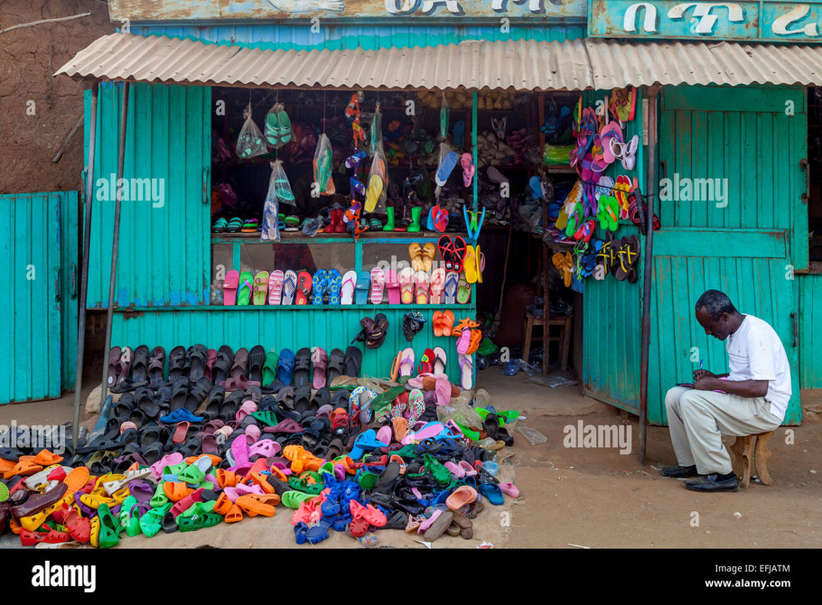
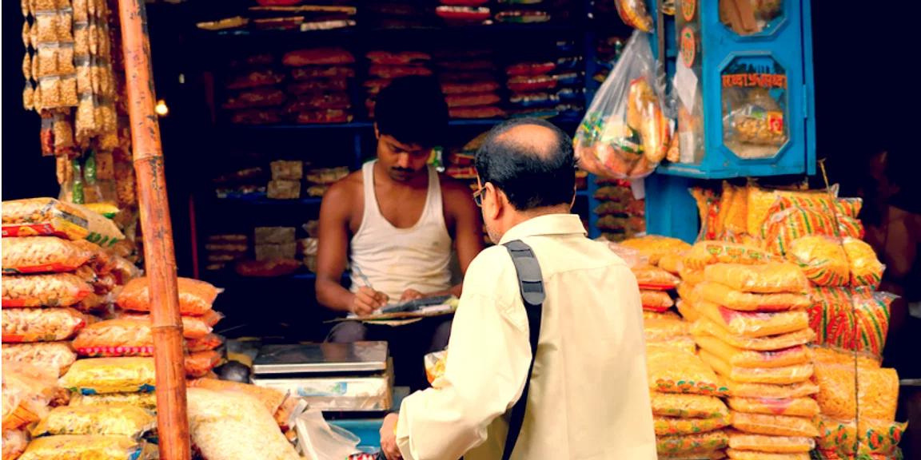

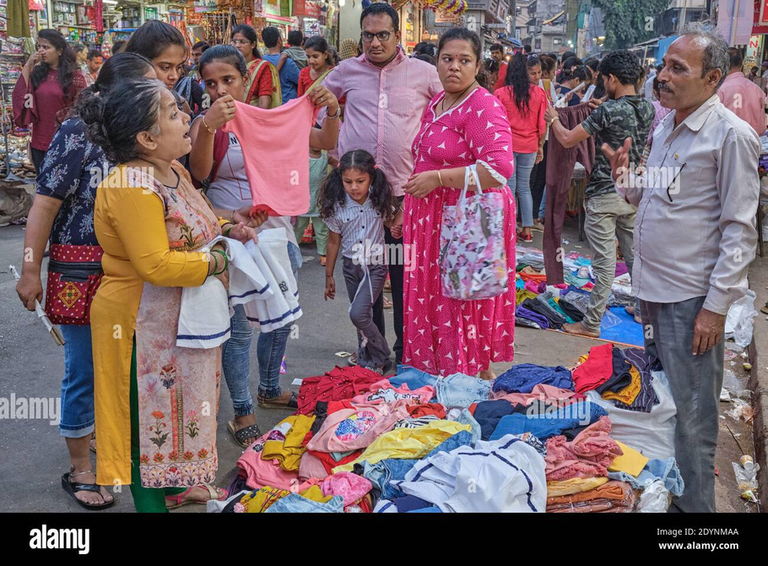
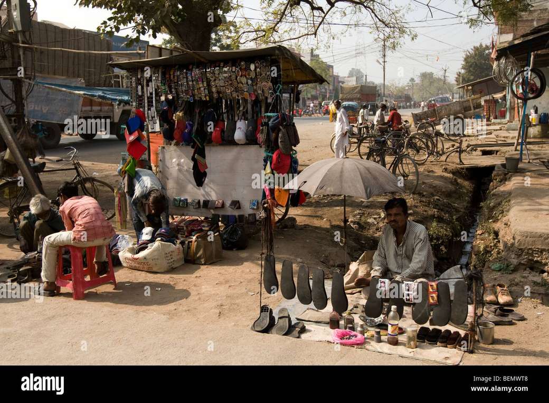


Slide 5

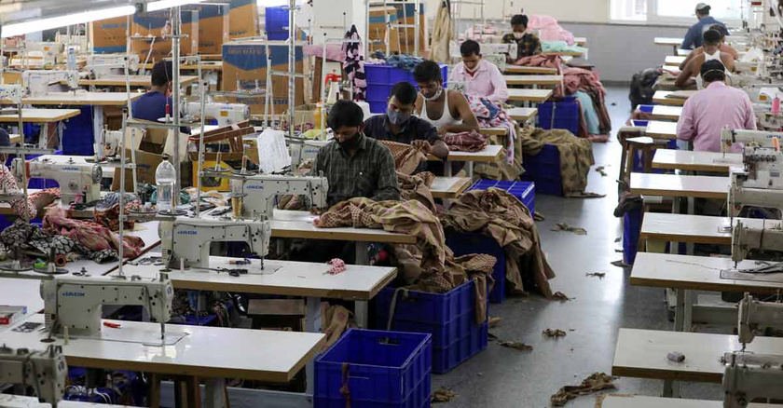

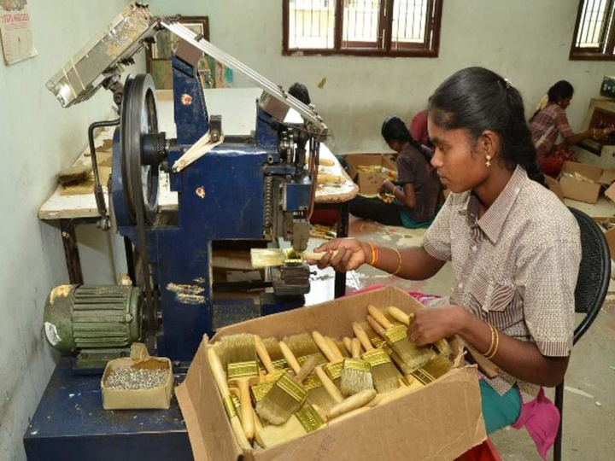
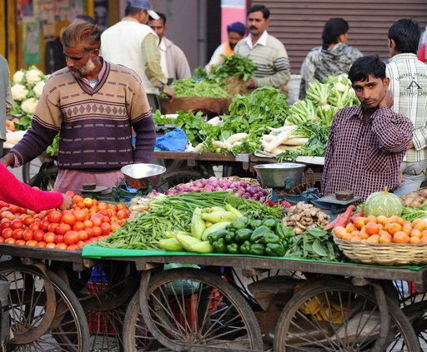
There are many Small Traders and Many small Business in India.
It is very Difficult to survive & No one is happy with their small Business.

Slide 6
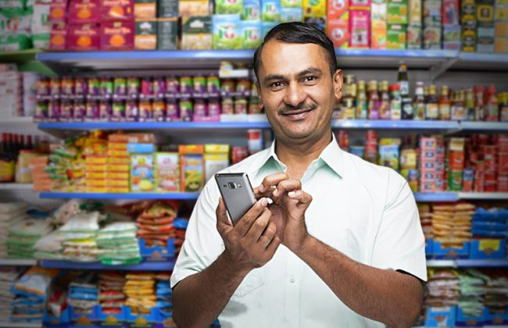


Revolution of DyB
DyB can provide a platforn to the users to develop their small business into major Business...

Slide 7



This software is specially developed for Every people (Poor,Middle class & Rich).
The main purpose of this Software is to give Employment to everyone in their desired field.
What ever the Customer is doing business ,he/she can able to develop their Business through this Software.
There is no age limit to do Business through this Software.
It gives more profit to the traders ,and all the Customers will Satisfies with this Software.
This Software is going to bring a new Revolution over the World in Future.
The Traders and The Customers will see Only Profit.

Slide 8




Technology Used For DyB
HTML
CSS
PHP
JAVA SCRIPT
HTML (HyperText Markup Language) is the code that is used to structure a web page and its content. For example, content could be structured within a set of paragraphs, a list of bulleted points, or using images and data tables.
CSS (Cascading Style Sheets) is used to style and layout web pages — for example, to alter the font, color, size, and spacing of your content, split it into multiple columns, or add animations and other decorative features.
PHP is an open-source, server-side programming language that can be used to create websites, applications, customer relationship management systems and more. It is a widely-used general-purpose language that can be embedded into HTML.
JavaScript (JS) is a cross-platform, object-oriented programming language used by developers to make web pages interactive. It allows developers to create dynamically updating content, use animations, pop-up menus, clickable buttons, control multimedia, etc.

Slide 9
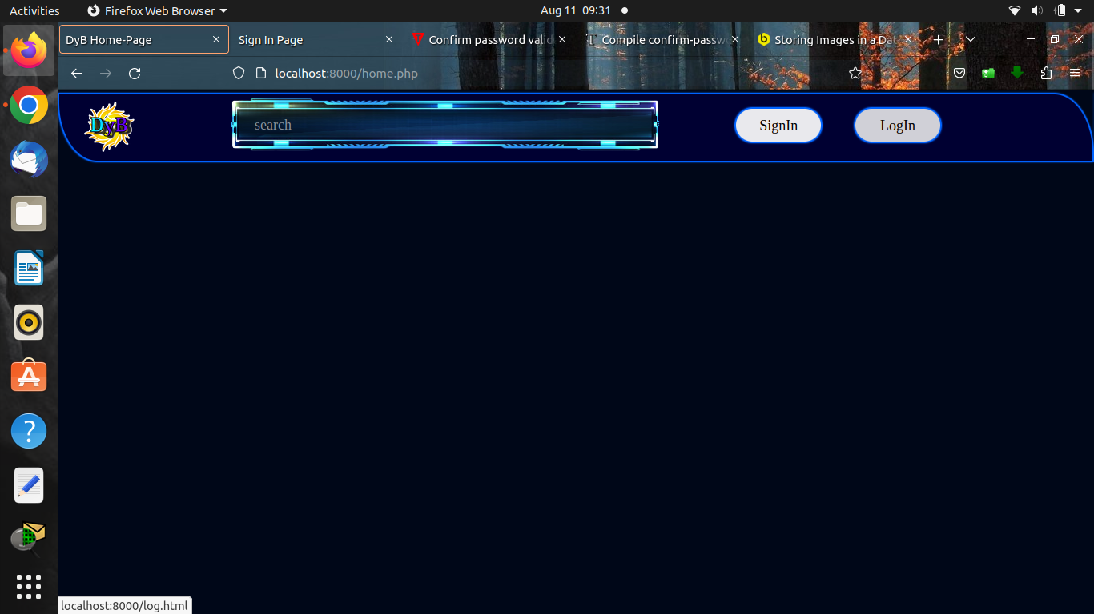

Slide 10
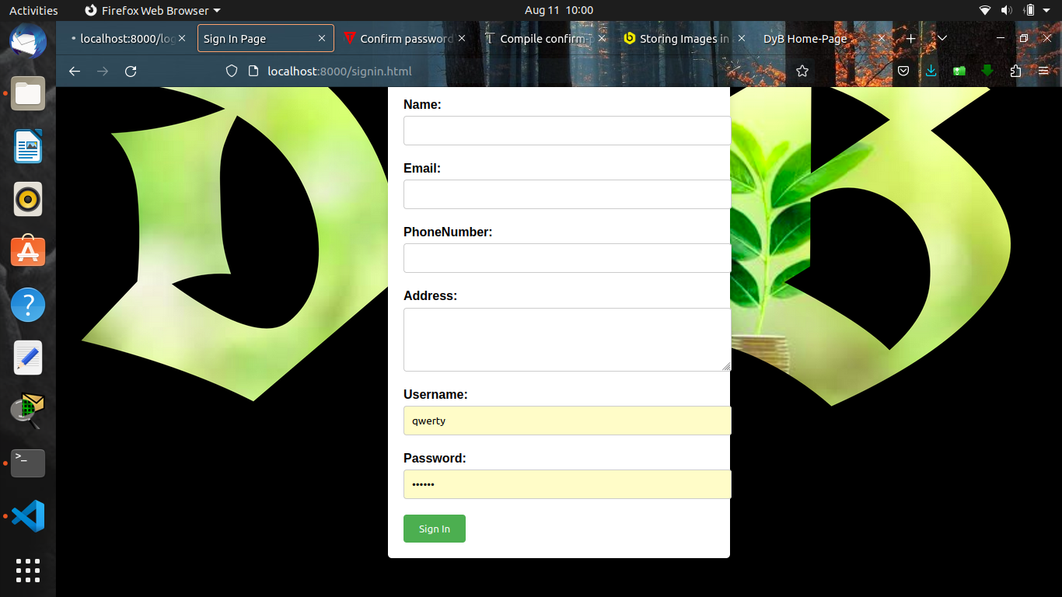

Slide 11
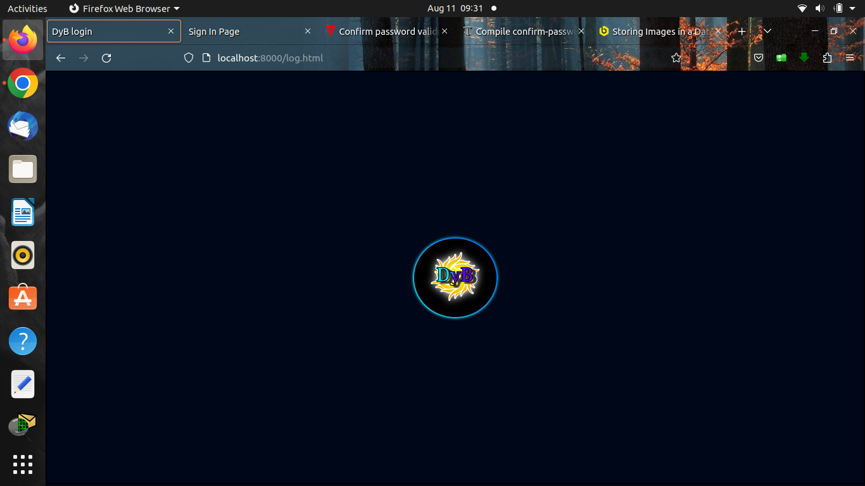

Slide 12
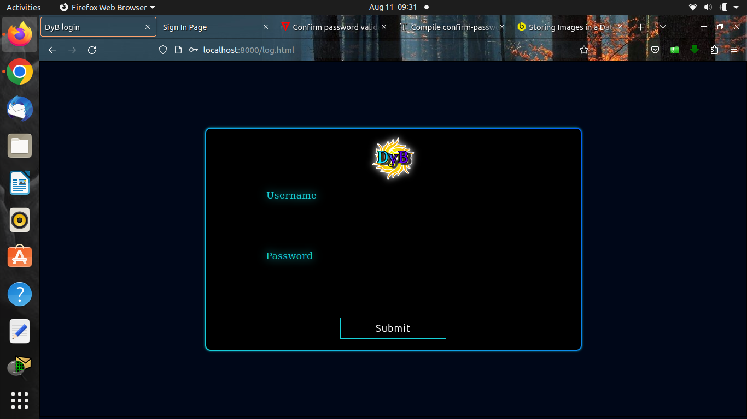

Slide 13
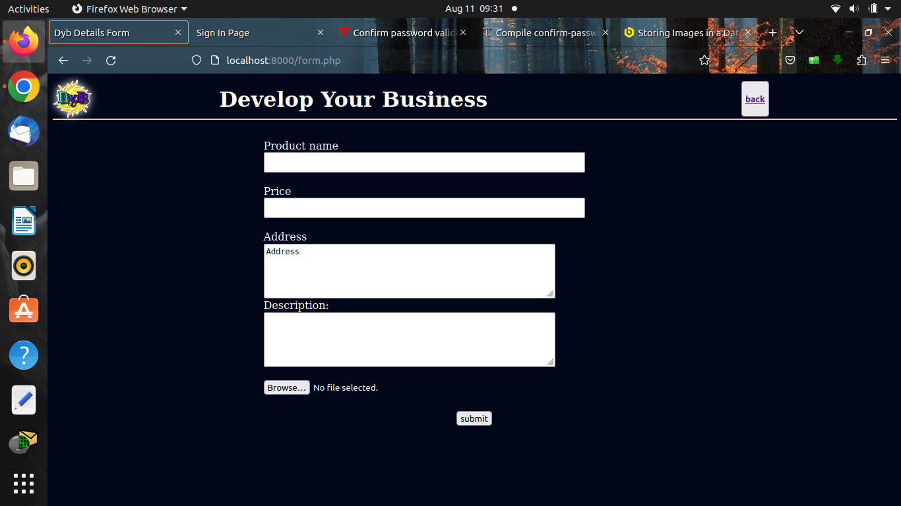

Slide 15
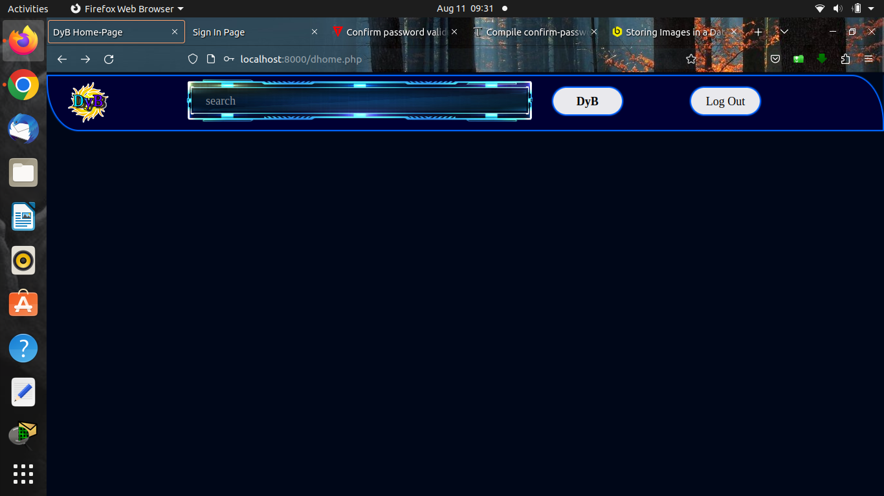

Slide 16

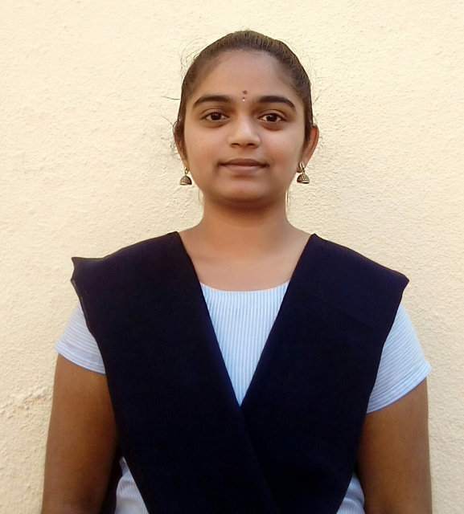
Our team
V.Ganesh Naik
V.NagaLatha
R180366
R180250
CSE , Section C
CSE , Section D

Slide 17



DyB
THANK YOU
For watching this presentation
+91 8341522895
vganeshnaik21@gmail.com
IIIT RGUKT RKVALLEY ,IDUPULAPAYA,PULIVENDULA

